Slide 1
Working with Numbers
Using numbers to support ideas

Slide 2
Numbers in Text
General rule of thumb:
  Write out numbers when counting
    “There were twenty-two people in attendance. Another two arrived late.”
  Use numerals when measuring
    “The squid varied in length from 10–15 cm and weighed 0.25–0.75 kg.”
  EXCEPTIONS: When the editor says so!

Slide 3
Numbers in Text (cont.)
Exceptions to the general “counting vs. measuring” rule of thumb:
  Use numerals when counting large, uneven numbers
    “During the 2009 home opener game, Dodger Stadium held 57,099 people—the largest number of spectators in Major League Baseball history.”
  QUESTION: What is a “large number”?
  ANSWER: It varies from more than nine, to more than ninety-nine. Ask your editor and/or see author’s guidelines for editorial policy.

Slide 4
Numbers in Text (cont.)
Even more rules about “counting vs. measuring!”
  Write out large, whole numbers when counting
    “One million registered Democrats lived in the center of a majority Republican stronghold, which complicated the election further.”
    “The IRS was unable to account for more than a billion dollars of election campaign funds that year.”
    “There were approximately one hundred elephants in the herd.”

Slide 5
Numbers in Text (cont.)
Hyphens and numbers
  Hyphenate compound quantities that are written out:
    “There are typically twenty-five students in each class.”
    [On a check]: Thirty-three and 56/100 dollars
  Hyphenate fractions that are written out:
    “The vote required a two-thirds majority to pass.”

Slide 6
Numbers in Text (cont.)
Avoid starting sentences with numerals:
  WRONG: “215 people attended the poetry reading.”
  RIGHT: “Approximately 215 people attended…”
  or…
  “The poetry reading was attended by 215 people.”
  EXCEPTIONS: When the editor says so!

Slide 7
Ordinal Numbers
Ordinals can be written out or expressed with numerals
    “She was the first person to arrive.”
      or…
    “The 2nd data point was anomalous.”
Superscripts are now optional for ordinals; however, still avoided by “purists.”
    They met at the corner of 1st Street and 2nd Avenue.”

Slide 8
Expressions of Time
Time is almost always expressed numerically in scientific text
    “The experiment was conducted between the hours of 0500 and 1200.”
      or…
    “The experiment commenced at 11:30 am.”
Whole times are sometimes written out
(esp. fiction)
    “They met at the strike of midnight.”
    “The birds began feeding around noon.”

Slide 9
Decimals vs. Commas
Not all countries use the decimal to indicate the radix point as we commonly do in the USA, i.e.,
    “The vehicle achieved an impressive 49.5 mpg.”
      or…
    “The largest specimen weighed 86.7 kilograms.”
For example:
    “The linear motor has a travel of 100,50 mm.”

Slide 10
Decimals vs. Commas (cont.)
When formatting numbers with thousands separators, note that both commas and thin spaces are used throughout the world:
  “The average monthly earnings of an American worker in 2002 was $36,764.”
  “The population of the United Kingdom in mid-2009 was 61 792 000, which was the third largest in Europe.”

Slide 11
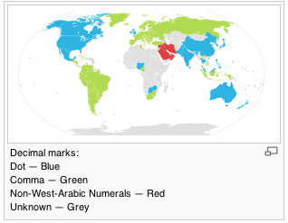
(SVG fr. Wikipedia.com 2010).

Slide 12
Decimals vs. Commas (cont.)
Fractional amounts should always be preceded by a 0 (zero) to help denote the MSB:
  WRONG: “The eggs obtained in the field weighed .15 kg.”
  RIGHT: “The eggs obtained in the field weighed 0.15 kg.”

Slide 13
Number Ranges
Number ranges are denoted with en dashes, not hyphens (a very common mistake)
  WRONG: “He was earning between $12.00-15.00 / hour.”
  RIGHT: “During the interval 2001–2005, IMF debt increased threefold throughout the developing world.”
  “The transect was conducted along north-south lines, varying between 10–12 kilometers, depending upon terrain.”

Slide 14
Editorial Consistency
Editorial consistency is the most ‘consistent’ rule
  If you handle numbers a certain way in one part of the text, handle them that way in all parts of the text.
  WRONG: “There were twenty-eight specimens from region A of the transect, and 38 specimens from region B.”
  RIGHT: “There were 28 specimens from region A of the transect and 38 specimens from region B.”

Slide 15
Editorial Consistency
Editorial consistency is the most consistent rule
  Editorial consistency applies to numerals too.
  WRONG: “Emergency contact: (805) 893-8000; informational contact: 805.893.1234”
  RIGHT: “Emergency contact: 805.893.8000; informational contact: 805.893.1234”

Slide 16
“Fewer” and “Less”
When talking about countable quantities:
  “There are fewer examples of flowering plants in desert regions.”
  “Fewer and fewer people attended the sessions.”
When talking about uncountable quantities:
  “There is less oxygen in the bell jar.”

Slide 17
“More” and “Greater”
When talking about group quantities and/or when making comparisons:
  “There are more examples of flowering plants in rain forests.”
  “More squid run in late September than in April.”
When talking about numeric quantities:
  “There is a greater concentration of DDT in the water after storm runoff.”

Slide 18
Representing Numbers Graphically
Numbers are represented graphically to:
  Show results
  Compare data
  Present trends
  Suggest anomalies
  Demonstrate correlations

Slide 19
Tables

Slide 20
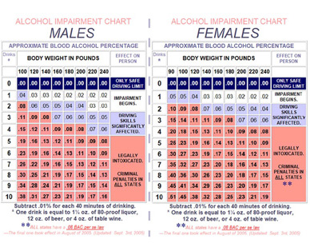

Slide 21
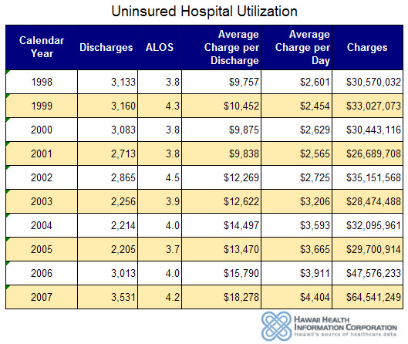

Slide 22
Comparing Data

Slide 23
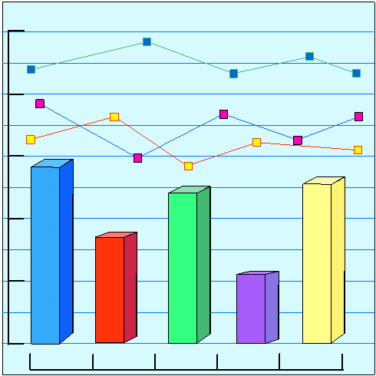

Slide 24
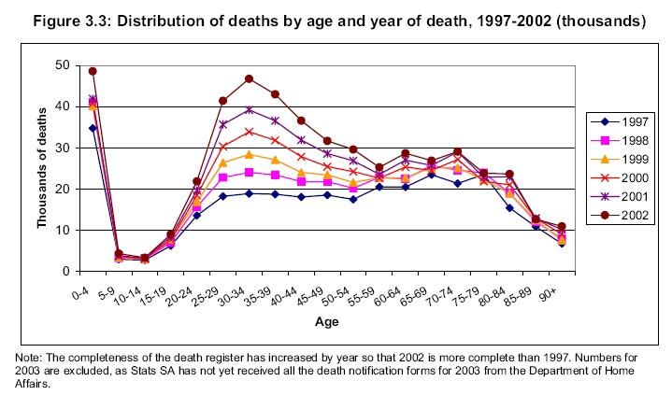

Slide 25
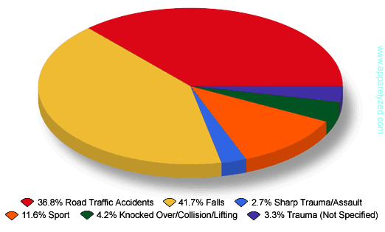

Slide 26
Presenting Trends

Slide 27
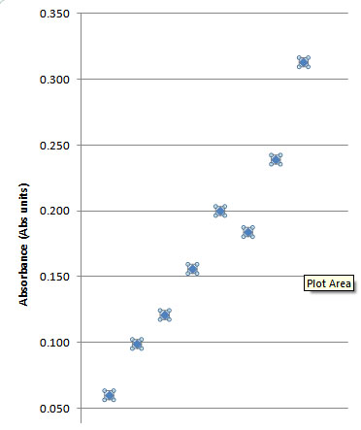

Slide 28
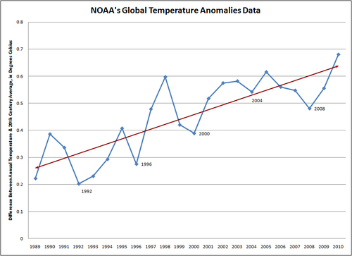

Slide 29
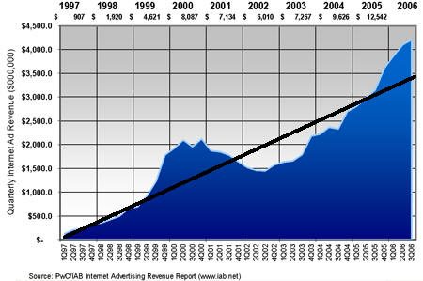

Slide 30
Suggesting Anomalies

Slide 31
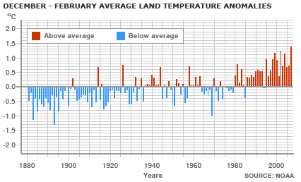

Slide 32
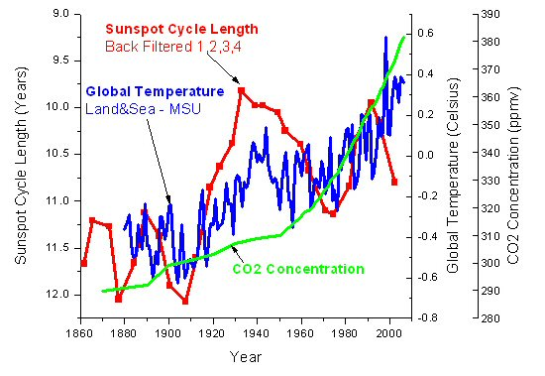

Slide 33
Numeric Innuendo

Slide 34
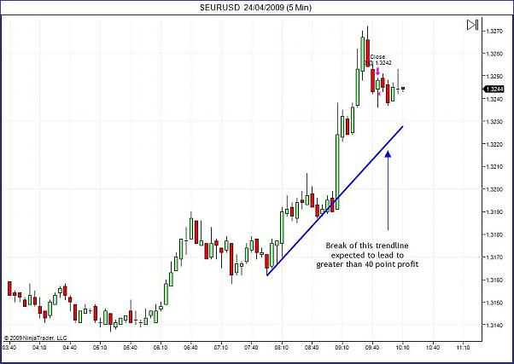

Slide 35
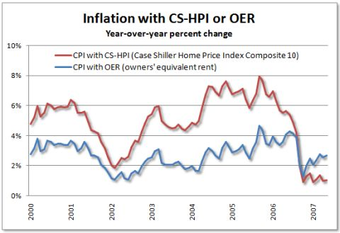

Slide 38
Let’s try an exercise…

Slide 39
Directions
Select any four (4) data points from your NationMaster.com information.
Generate one honest/accurate picture of your data using any form of numeric representation (graph, bar chart, pie chart, scattergram, etc.)
Generate one dishonest/inaccurate numeric representation of any four data points.
NOTE THE SOURCE(S) OF DATA!

